Slide 1
2. Write a C program to implement Dijkstra’s
algorithm for the single source shortest
path problem.

Slide 2
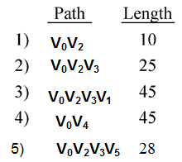
The Single-Source Shortest path Problem ( SSSP)
Given a positively weighted directed graph G with a source vertex s, find the shortest paths from s to all other vertices in the graph.
Ex :-
45
s
v₀
50
v₁
10
v₄
15
35
10
20
20
30
v₂
15
v₃
3
v₅
a) Directed Graph
b) Shortest paths from v₀

Slide 3
Graph & adjacency / cost Matrix
V0 V1 V2 V3 V4 V5
V0 ∞ 50 10 ∞ 45 ∞
V1 ∞ ∞ 15 ∞ 10 ∞
V2 20 ∞ ∞ 15 ∞ ∞
V3 ∞ 20 ∞ ∞ 35 3
V4 ∞ ∞ ∞ 30 ∞ ∞
V5 ∞ ∞ ∞ ∞ ∞ ∞
45
s
v₀
50
v₁
10
v₄
15
35
10
20
20
30
v₂
15
v₃
3
v₅
V0 V1 V2 V3 V4 V5
V0 999 50 10 999 45 999
V1 999 999 15 999 10 999
V2 20 999 999 15 999 999
V3 999 20 999 999 35 3
V4 999 999 999 30 999 999
V5 999 999 999 999 999 999
a) Directed Graph
Note : As we can not get infinity in a program, use 999 as infinity.

Slide 4
main() function, reading i/p & calling dijkstra funtion
#include<stdio.h>
#include<conio.h>
#define MAX 10
void dijkstra(int cost[MAX][MAX], int n, int sourcevertex);
void main()
{ int cost[MAX][MAX], i, j, n, sourcevertex;
printf("Enter no. of vertices:");
scanf("%d",&n);
printf("Enter the cost matrix:\n");
for(i=0;i<n;i++)
for(j=0;j<n;j++)
scanf("%d",&c[i][j]);

Slide 5
printf("Enter source vertex:");
scanf("%d",&sourcevertex);
dijkstra(cost, n, sourcevertex);
}

Slide 6
SSSP-Dijkstra’s algorithm
1. Dijkstra’s algorithm assumes that cost(e)≥0 .
2. Maintains a set of vertices S(visited) whose shortest
paths from source node have already been determined.
code : int visited[ 10];
for( i=0; i<10; i++ )
{ visited[ i ] = 0; }
visited[ 0 ] = 1;
As soon as shortest path of a vertex is calculated, mark it as
completed by changing value to 1.

Slide 7
3. Declare an array distance[ ] to store shortest paths of vertices
from source node. Initially, initialize it with first row of cost
matrix.
int distance[10];
for( i=0; i<10; i++ )
{
distance[ i ] = c[ sourcenode ][ i ]
}
V0 V1 V2 V3 V4 V5
V0 0 50 10 999 45 999
V1 --- --- --- --- --- ---

Slide 8
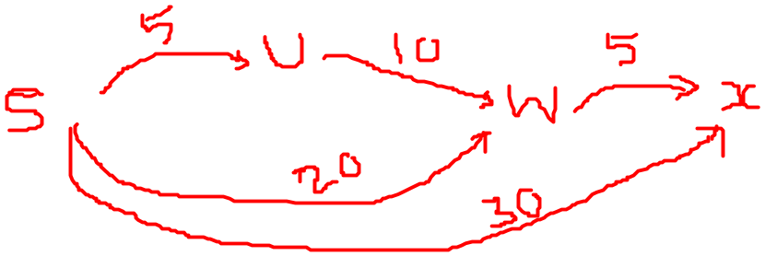
4. Whenever path of a vertex w is updated via particular vertex u , store u as the predecessor of w to print the whole shortest path.
pred[ w ] = u;
Initially, initialize sourcenode as predecessor to all the vertices.
for(i=0;i<n;i++)
{
pred[i]=sourcevertex;
}

Slide 9

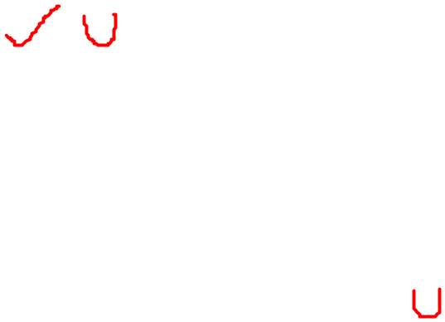
4. a) Select the next minimum distance vertex u, which is not in S.
b) for each node w adjacent to u do
  if( distance[ w ] > dist[ u ] + cost[ u, w] )
  { distance[w] = dist[ u ] + cost[u, w];
  pred[ w ] = u ; }
5. Repeat step (a) and (b) until S=n (number of vertices).
Updating paths via vertex v2
distance[ 1 ] = 50
distance[ 3 ] = 25
distance[ 4 ] = 45
distance[ 5 ] = 999
pred[ 3] = 2
During 1st iteration
distance[1] = 50
v0 v1
v0 v2
v0 v3
v0 v4
v0 v5
45
distance[2] = 10
s
50
v₁
10
v₄
v₀
distance[3] = 999
15
10
35
distance[4] = 45
20
20
30
v₂
15
v₃
3
v₅
distance[5] = 999

Slide 10
45
45
0
50
1
10
4
0
50
1
10
4
15
15
10
35
35
20
20
30
20
10
20
30
2
15
3
3
5
2
15
3
3
5
✓
Iteration | S | dist[1] | dist[2] | dist[3] | dist[4] | dist[5]
Initial | {0} | 50 | 10 | ∞ | 45 | ∞

Slide 11
45
45
50
1
10
4
50
1
✓
10
4
0
0
15
✓
15
35
35
10
20
20
30
20
10
20
30
2
15
3
3
5
2
15
3
3
5
✓
✓
✓
Iteration | S | Dist[1] | Dist[2] | Dist[3] | Dist[4] | Dist[5]
Initial | {0} | 50 | 10 | ∞ | 45 | ∞
✓
1 { 0,2 } 50 25 45 ∞
✓
✓
2 { 0,2,3 } 45 45 28
✓
✓
3 { 0,2,3,5 } 45 45
✓
✓
4 { 0,2,3,4,5 } 45
✓
✓

Slide 12
void dijkstra(int cost[MAX][MAX], int n, int sourcevertex)
{ int pred[MAX], visited[MAX], distance[MAX];
int count, mindistance, nextnode, i, j, nextvertex
//pred[ ] stores the predecessor of each node
//count gives the number of nodes seen so far
//initialize pred[],distance[] and visited[]
for(i=0;i<n;i++)
{
distance[i]=cost[startnode][i];
pred[i]=sourcevertex;
visited[i]=0;
}
distance[sourcevertex]=0;
visited[sourcevertex]=1;
count=1;

Slide 13
while(count<n-1)
{
mindistance=999;
//next vertex is the vertex at minimum distance & whose shortest path not //yet determined
for(i=0;i<n;i++)
if( distance[i] < mindistance && !visited[i] )
{
mindistance=distance[i];
nextvertex=i;
}
visited[nextvertex]=1;

Slide 14
//check if a better path exists through nextvertex
for(i=0; i<n; i++)
if( !visited[i] )
if( mindistance + cost[nextvertex][i] < distance[i] )
{ distance[i] = mindistance + cost[nextvertex][i];
pred[i] = nextvertex;
}
count++;
} // while end

Slide 15
//print the path and distance of each node
for( i=0; i<n; i++)
if( i!=sourcenode)
{
printf("\nDistance of node %d = %d ", i, distance[i] );
printf("\nPath=%d",i);
j=i;
do
{
j=pred[j];
printf("<-%d", j);
}while( j !=sourcenode);
}
}

Slide 16
Your o/p should look like as shown below:
Eneter number of vertices
6
Eneter cost matrix
999 50 10 999 45 999
999 999 15 999 10 999
20 999 999 15 999 999
999 20 999 999 35 3
999 999 999 30 999 999
999 999 999 999 999 999
Enter source vertex
0
Distance of node 1 is 10
Path : 2←0
Distance of node 2 is 25
Path : 3←2←0
---------

